Slide 1


Sr 77 wildlife elements
Background
Final Planning / Design = January 2021
Estimated Construction = June 2021

Slide 2
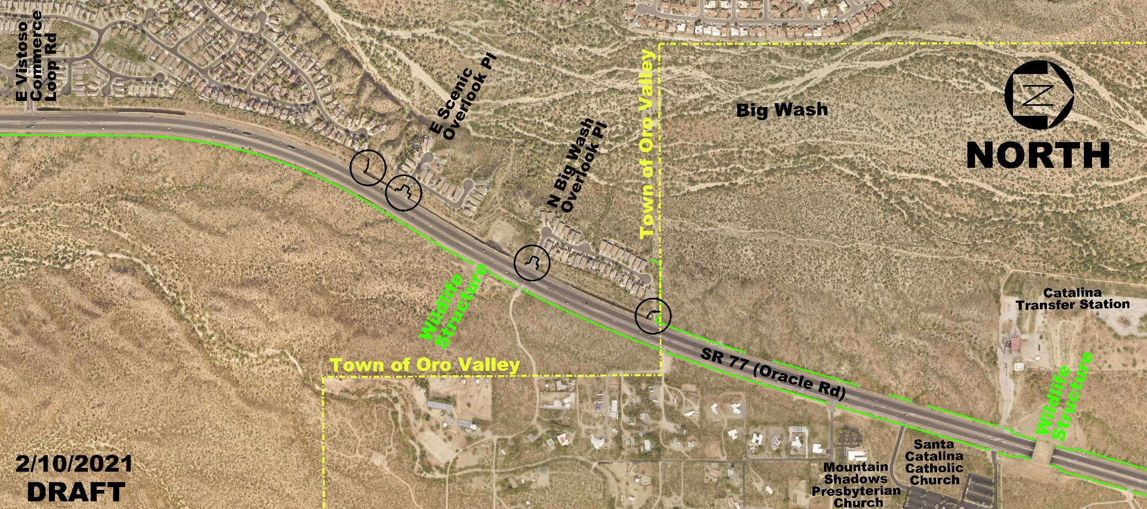
Sr 77 wildlife elements
LOCATION MAP

Slide 3
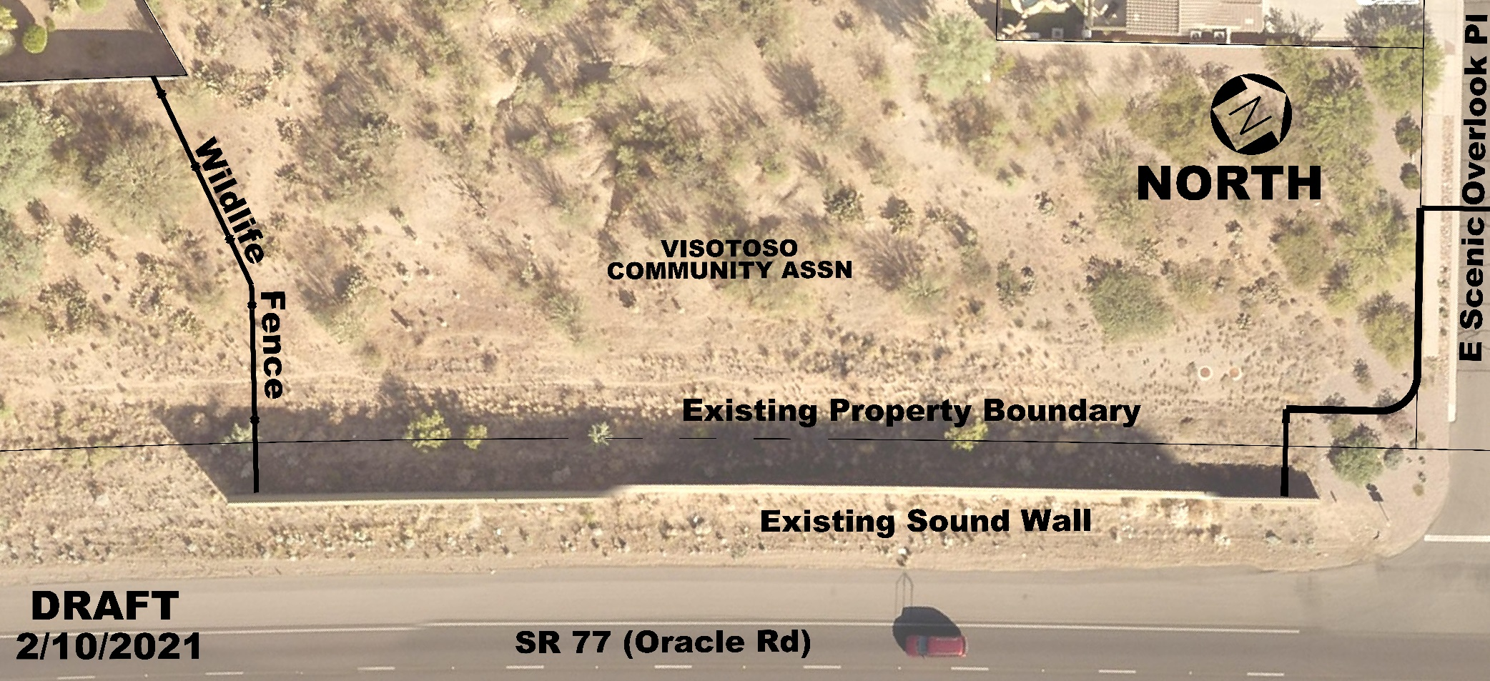
Sr 77 wildlife elements
SOUTHERN END
6’ High Wildlife Fence
6’ High Wildlife Fence Gate

Slide 4
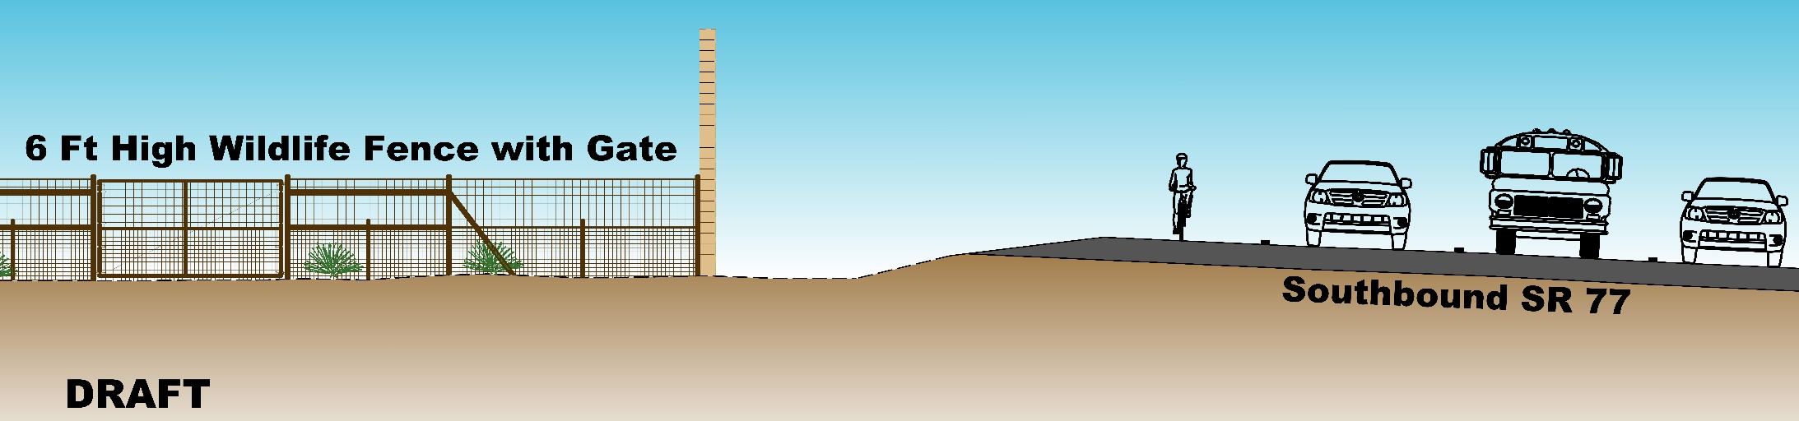
Sr 77 wildlife elements
LOOKING NORTH

Slide 5
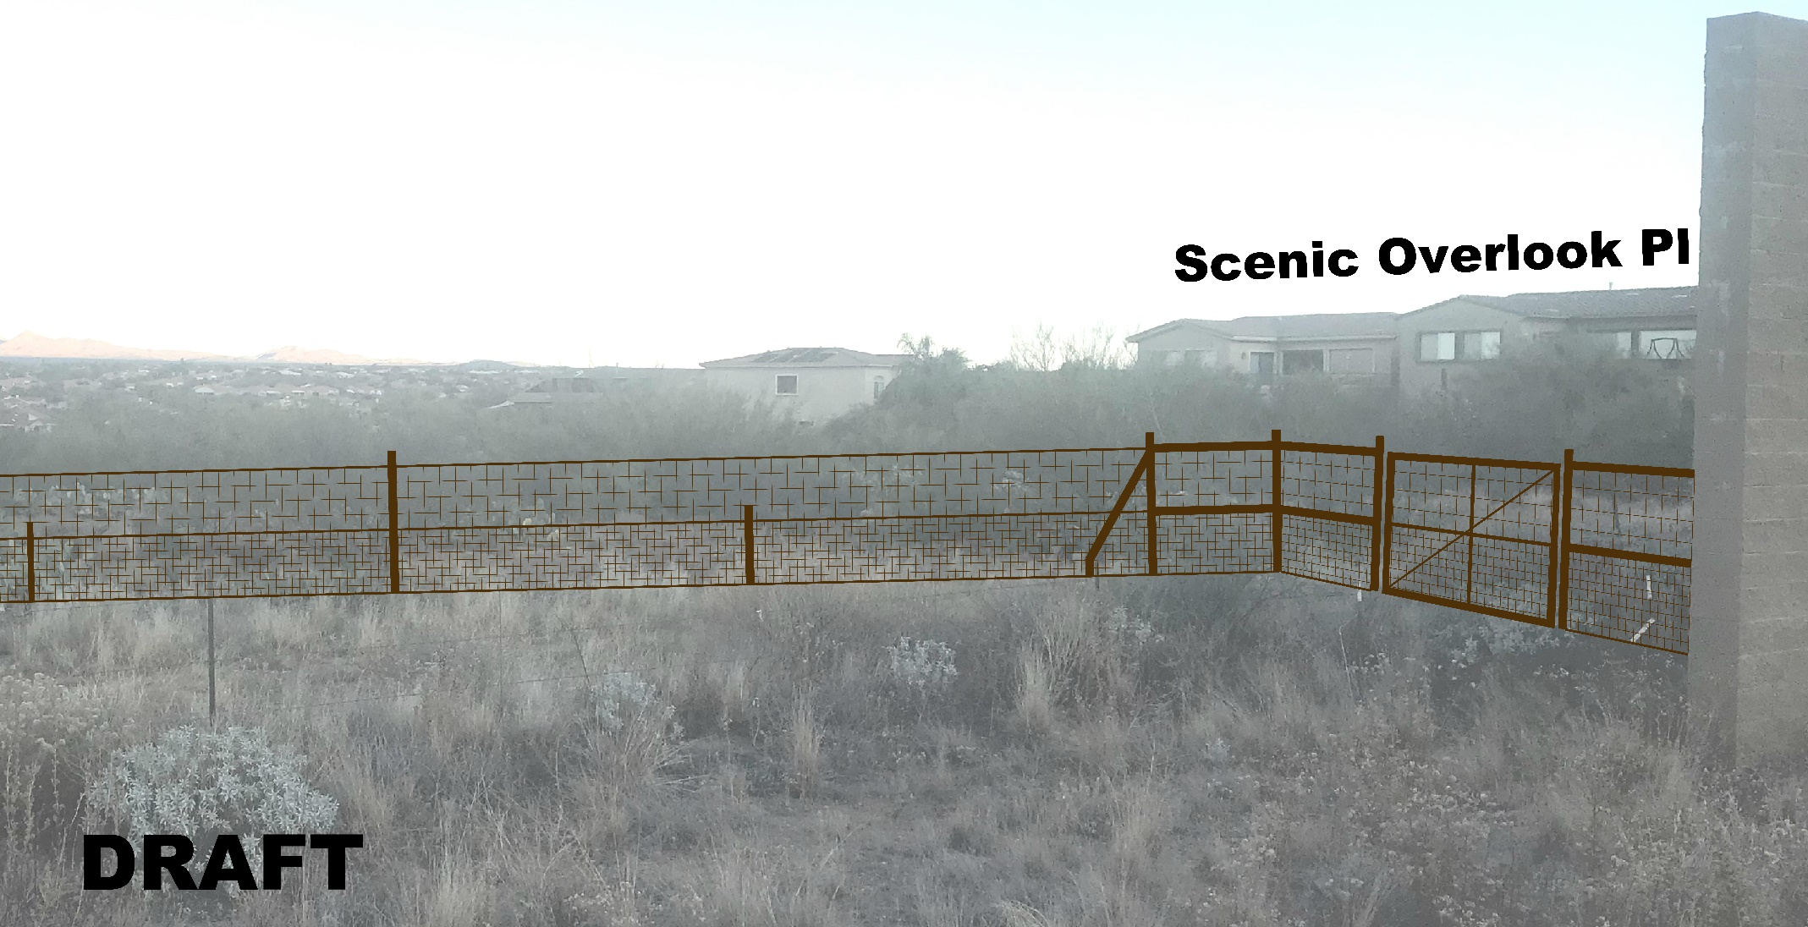
Sr 77 wildlife elements
LOOKING NORTHWEST

Slide 6
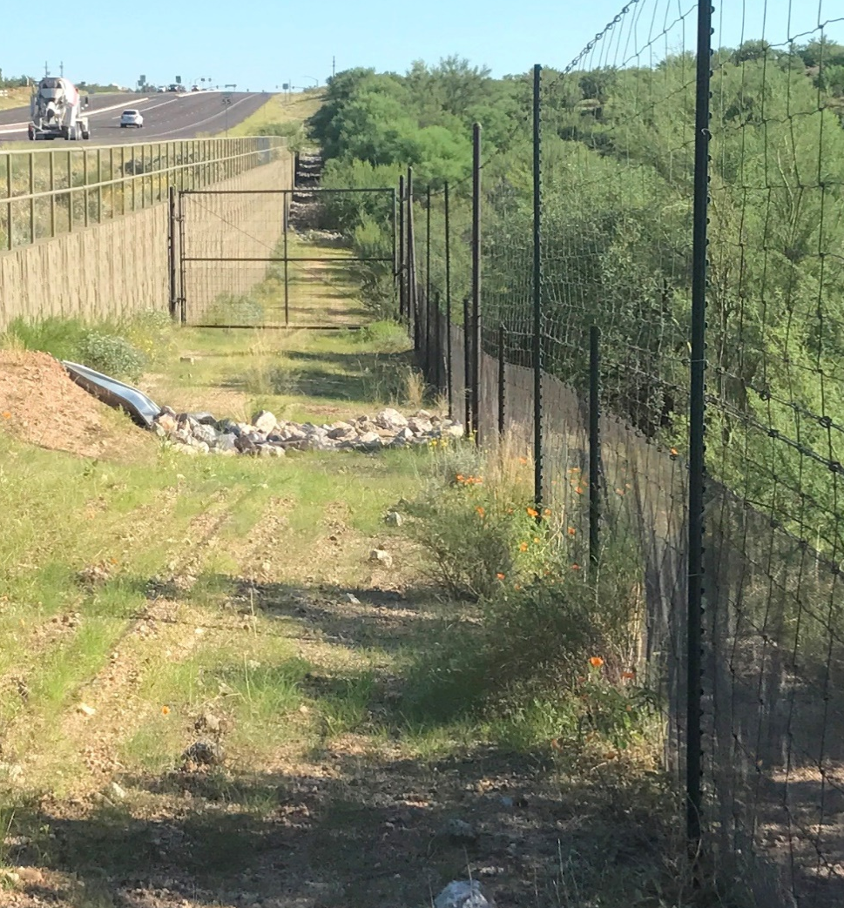
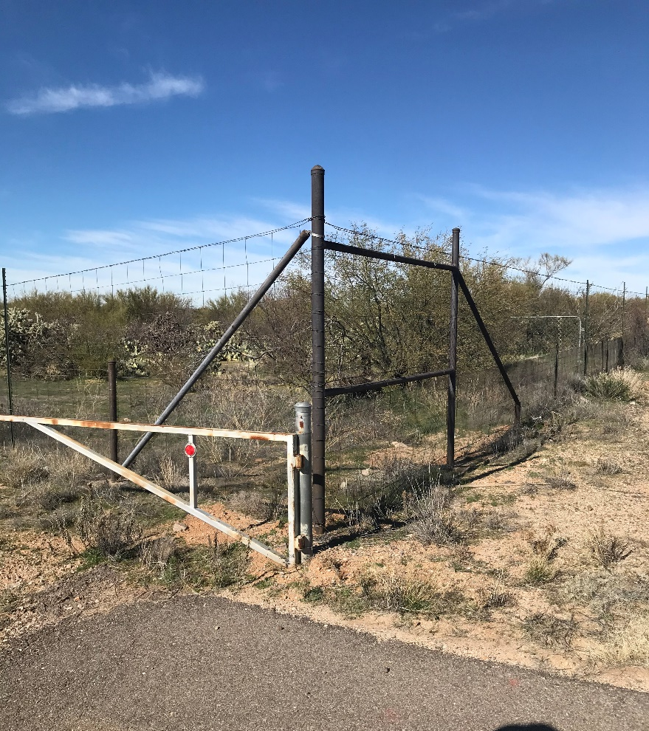
Sr 77 wildlife elements
EXISTING WILDLIFE FENCING

Slide 7
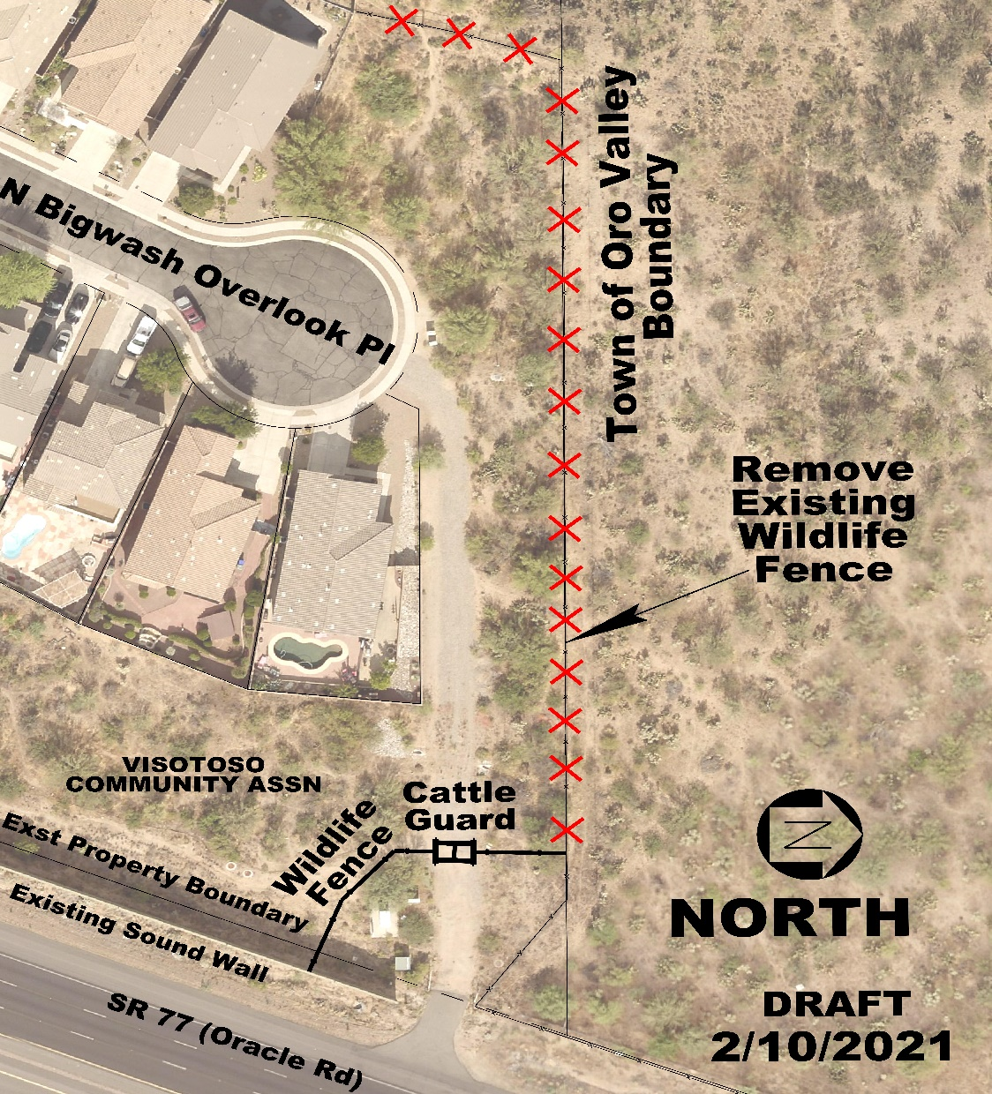
Sr 77 wildlife elements
NORTHERN END
Remove Existing Wildlife Fence
New Cattle Guard
6’ High Wildlife Fence

Slide 8
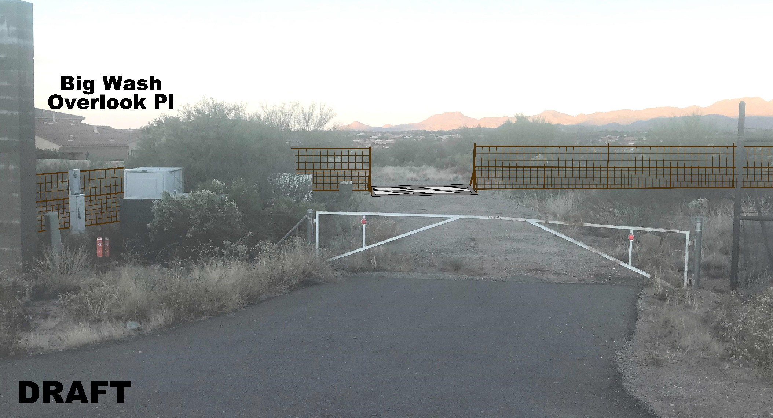
Sr 77 wildlife elements
LOOKING WEST

Slide 9
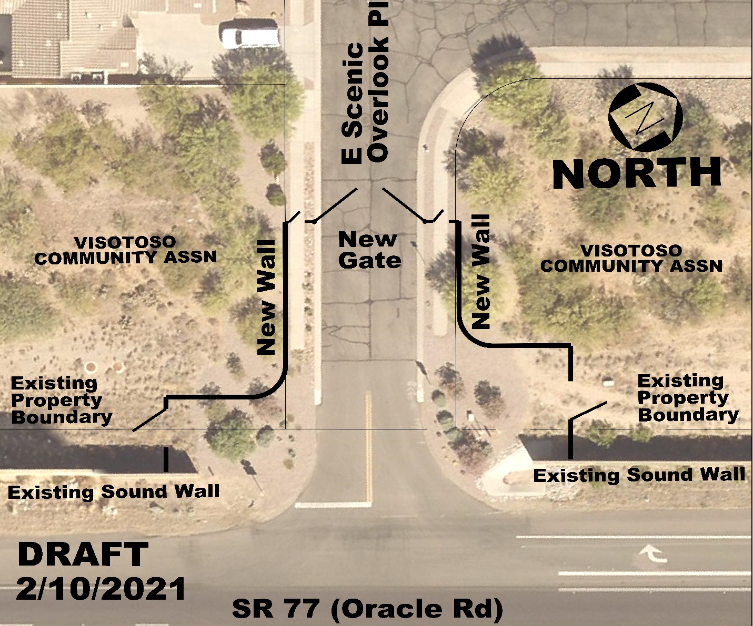
Sr 77 wildlife elements
Scenic overlook pl
Roadway Entry Gate
6’ High Combination
View Fence/Masonry Wall
Pedestrian Gates
Maintenance Gates

Slide 10
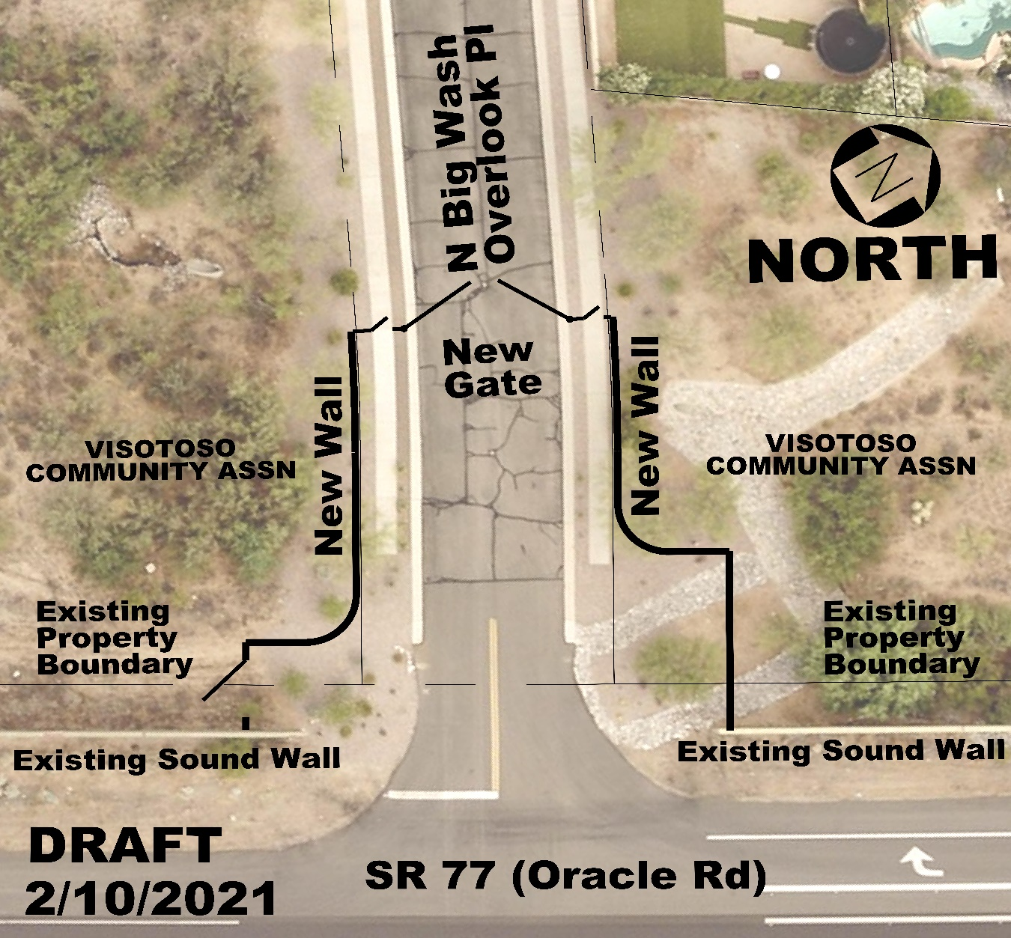
Sr 77 wildlife elements
Big wash overlook pl
Roadway Entry Gate
6’ High Combination
View Fence/Masonry Wall
Pedestrian Gates
Maintenance Gate

Slide 11
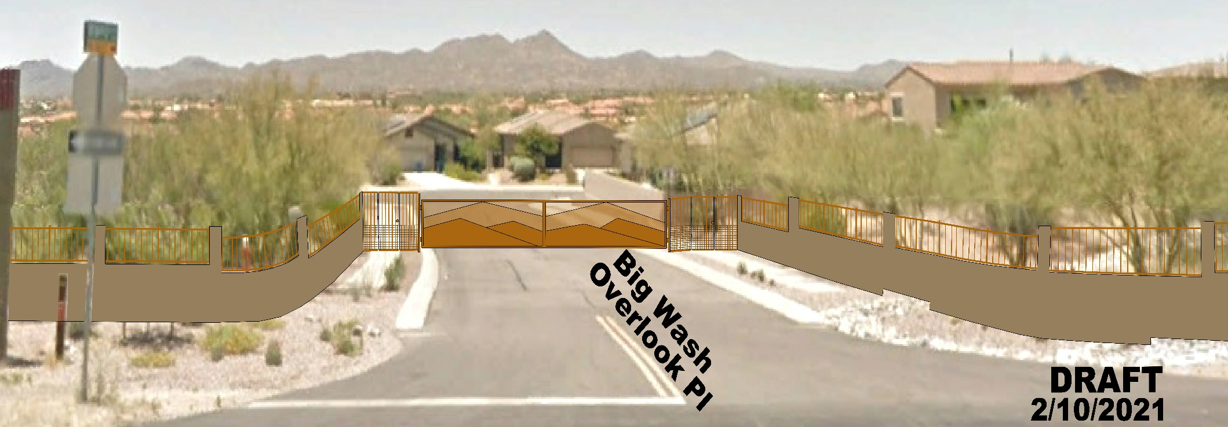
Sr 77 wildlife elements
Looking west

Slide 12
Sr 77 wildlife elements
Questions?

