Slide 1
Residences at Morning Vista
Conceptual design review

Slide 2
Conceptual Review
Site Plan
Landscape Plan
Architectural Plans

Slide 3
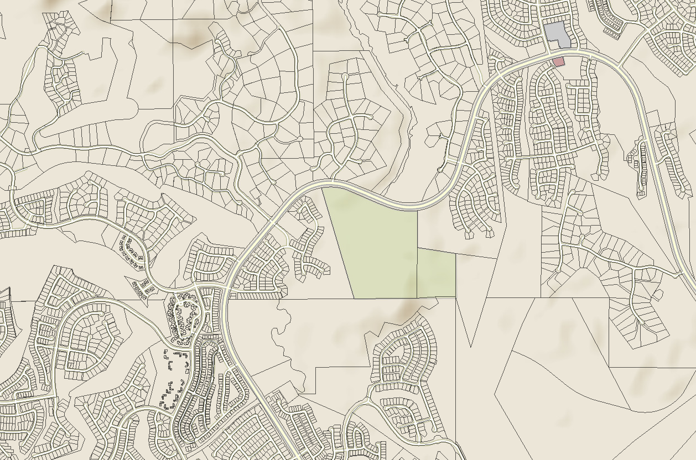
Location Map
Honey Bee Wash
Stone Canyon
Tortolita Mountain Cir
Rancho Vistoso Blvd
Vistoso Highlands Dr
Honey Bee Canyon Park
Splendido
Rancho Vistoso Blvd
N

Slide 4
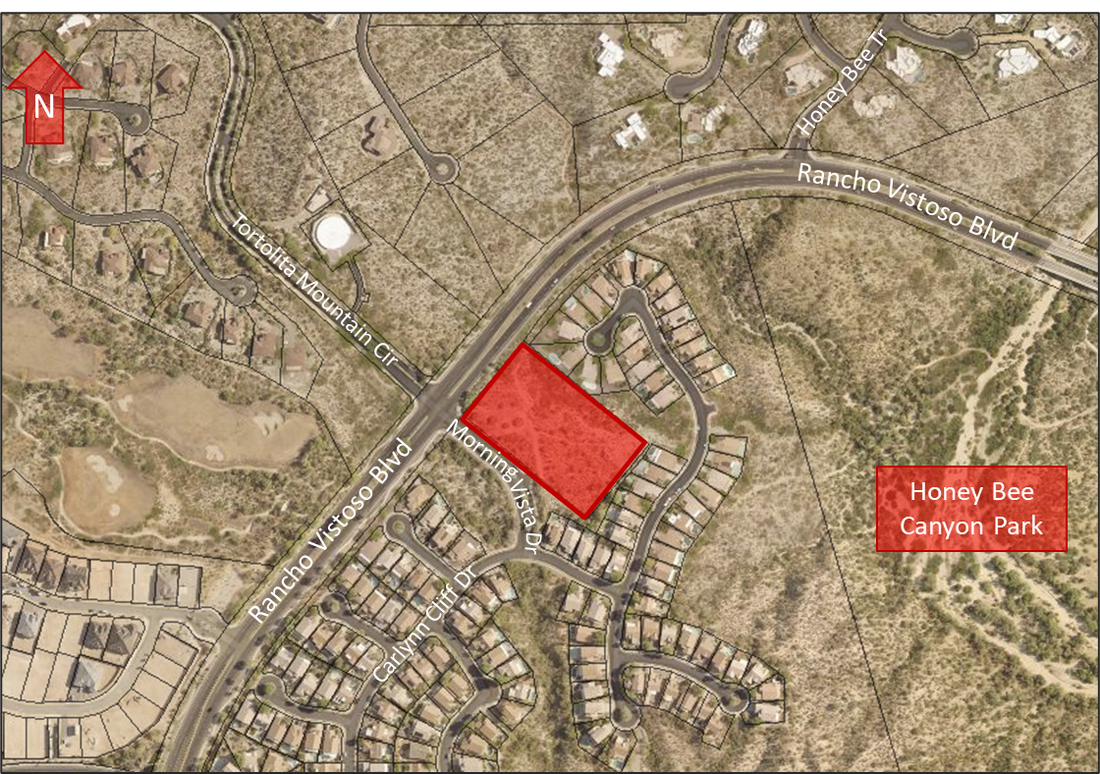
Context Map
Project Site
Bushwacker Pl

Slide 5
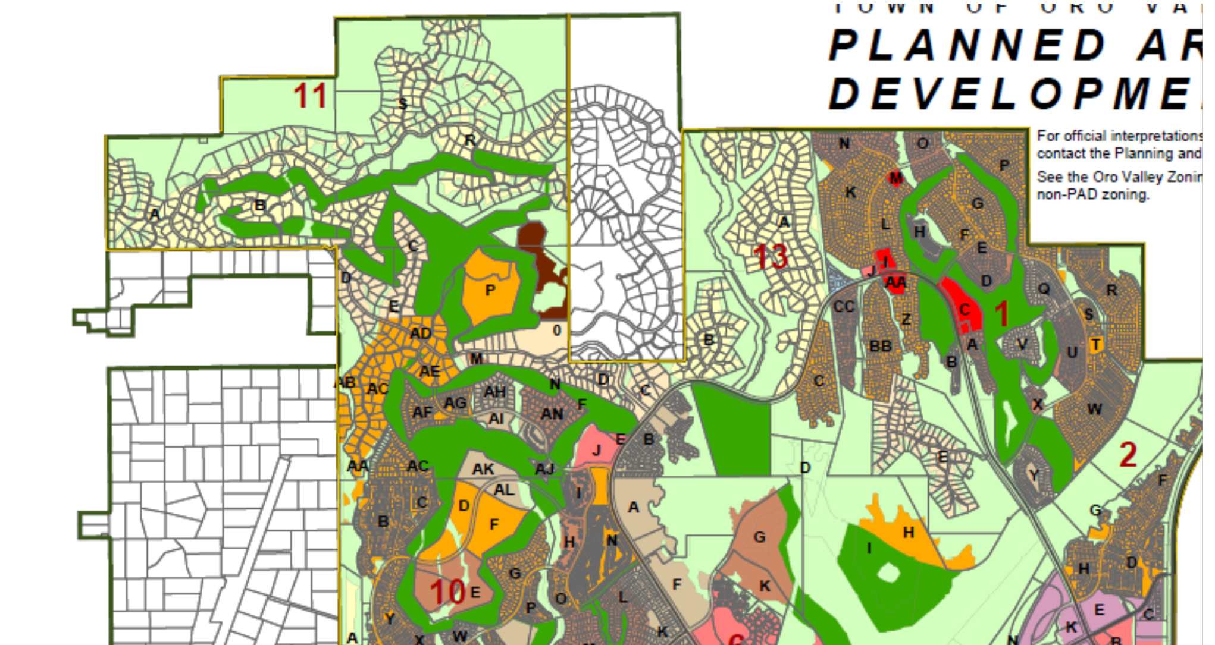
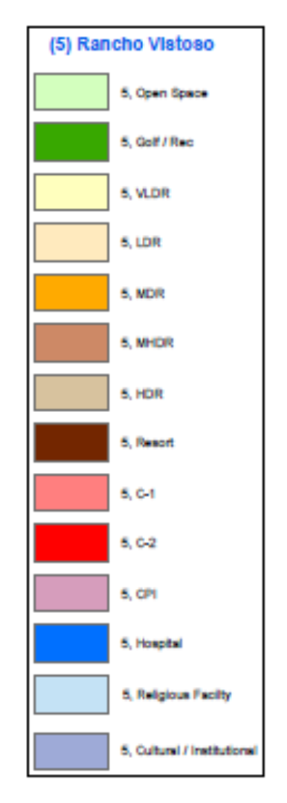
Rancho Vistoso Land Use Map
Open Space
Golf/Rec
VLDR
LDR
MDR
MHDR
HDR
Resort
C-1
C-2
CPI
Hospital
Religious Facility
Cultural/Institutional

Slide 6
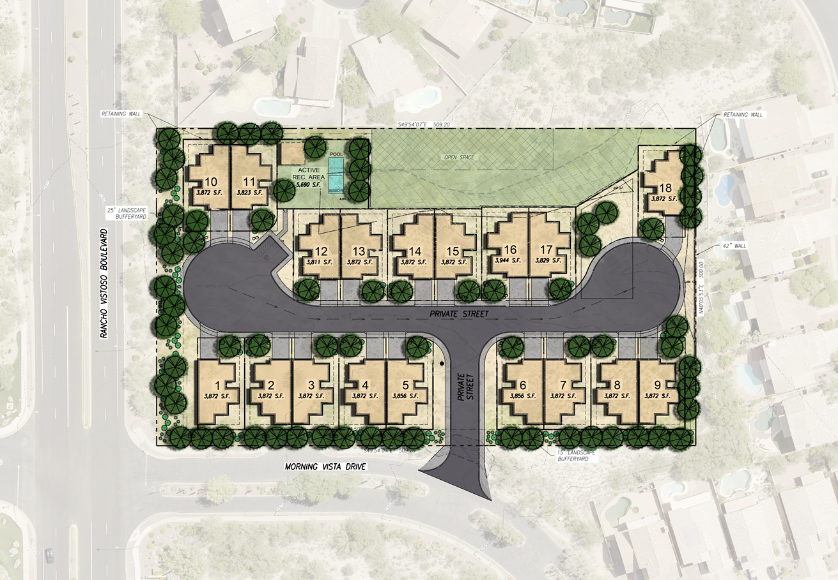
Conceptual Site/Landscape Plan
Project Area: 3.5 acres
Number of Townhomes: 18
Project Density: 5.14 RAC
Permitted Density (HDR): 8-17 RAC
Proposed Building Height: 16 feet/1 story
Permitted Building Height: 34 feet/3 stories

Slide 7
Conceptual Architectural Design
Front elevation

Slide 8
Conceptual Architectural Design
side elevation

Slide 9
Conceptual Architectural Design
rear elevation

Slide 10
Conceptual Architectural Design
View from northeast

Slide 11
Conceptual Architectural Design
View from northwest

Slide 12
Conceptual Architectural Design
View from southeast

Slide 13
Conceptual Architectural Design
View from southwest

Slide 14
Questions?
Contact Information
Keri Silvyn | Lazarus & Silvyn, P. C.
KSilvyn@LSLawAZ.com | 520.207.4464
Robin Large | Lazarus & Silvyn, P. C.
RLarge@LSLawAZ.com | 520.207.4464

Slide 15
Conceptual Design Review Process
Application Submittal & Staff Review
Late May 2021
Planning & Zoning Commission
Mayor & Council
Neighborhood Meeting
Begin Final Design Review Process
May 20, 2021

