Slide 1
Southeast corner of Tangerine and La Cholla Type 1 General Plan Amendment and Rezoning
Neighborhood Meeting
April 27, 2022
Ground Rules for Neighborhood Meetings
Be respectful of all participants.
Celebrate areas of agreement.
Work on areas of disagreement respectfully.
Listen to each other and do not interrupt.
Focus on the issue at hand – and only the issue at hand.
Silence our cell phones to minimize interruptions.
Notes:
Good evening…
My name

Slide 2
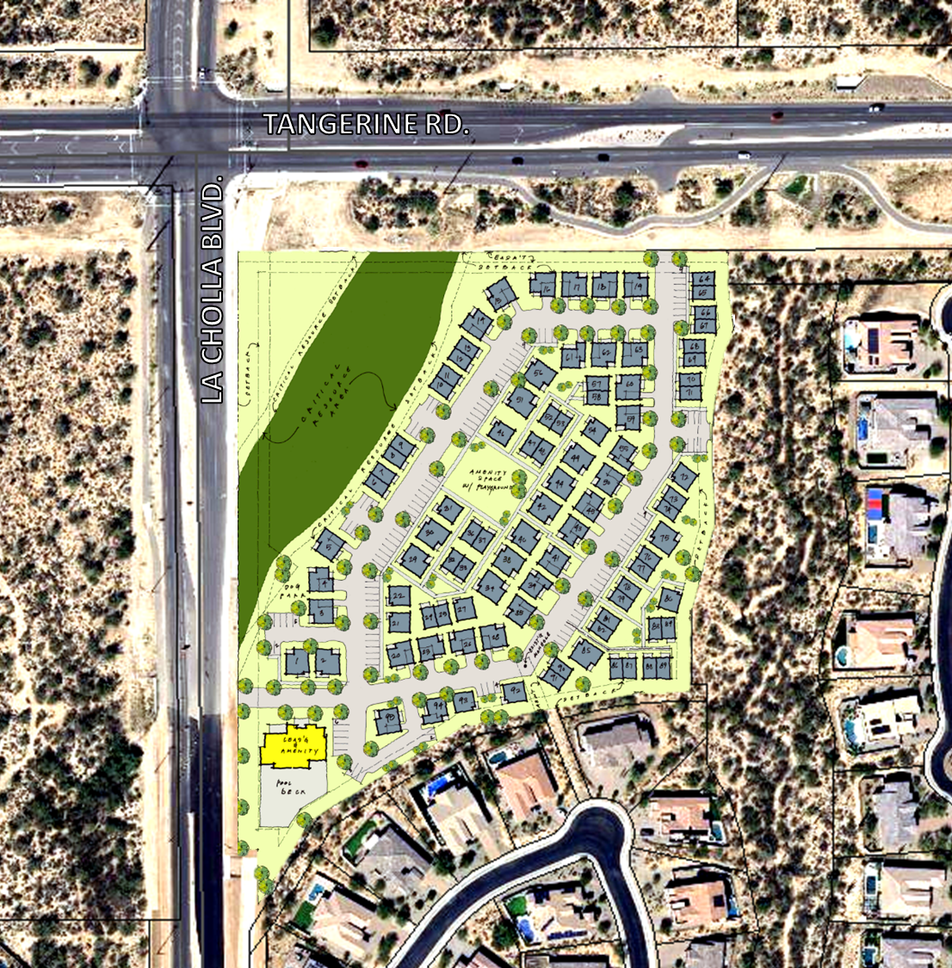
Purpose
Purpose
INFORM, LISTEN AND ADDRESS YOUR CONCERNS
Opportunities to stay involved
Brief overview by staff
Applicant presentation
YOUR TURN!
Upcoming meetings
Rams
Canyon & Pass

Slide 3
Informational Video – posted on OVprojects.com April 12, 2022
Formal submittal
2nd Neighborhood Meeting – August (tentatively)
1st Planning and Zoning Commission Hearing – October (tentatively)
Town Council Hearing – December (tentatively)
1st Neighborhood Meeting – April 27, 2022
2nd Planning and Zoning Commission Hearing – November (tentatively)
We are here
Questions: ask@orovalleyaz.gov
Info: www.OVprojects.com

Slide 4
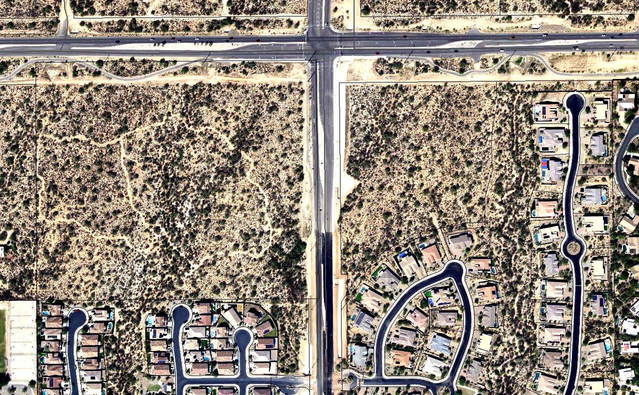
Location Map
TANGERINE RD.
LA CHOLLA BLVD.
Subject
Property
Rancho del Cobre
Rancho del Plata
Notes:
Our purpose is to go over:
1. New information == Formal resubmittal
2. Summarize the 1st neighborhood meeting
- quickly go over the issues identified
3. Applicant to discuss their efforts to address those issues

Slide 5
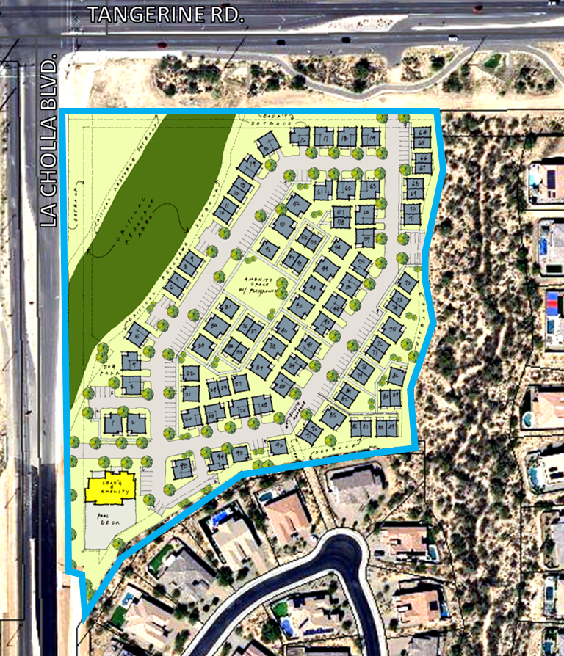
Applicant’s proposal
Type 1 General Plan Amendment
Neighborhood Commercial/ Office (NCO) to High Density Residential (HDR)
Rezoning
Neighborhood Commercial (C-N) to Multi-family (R-6)
95 rental units
1 and 2-story
Detached and attached
2 access points

Slide 6
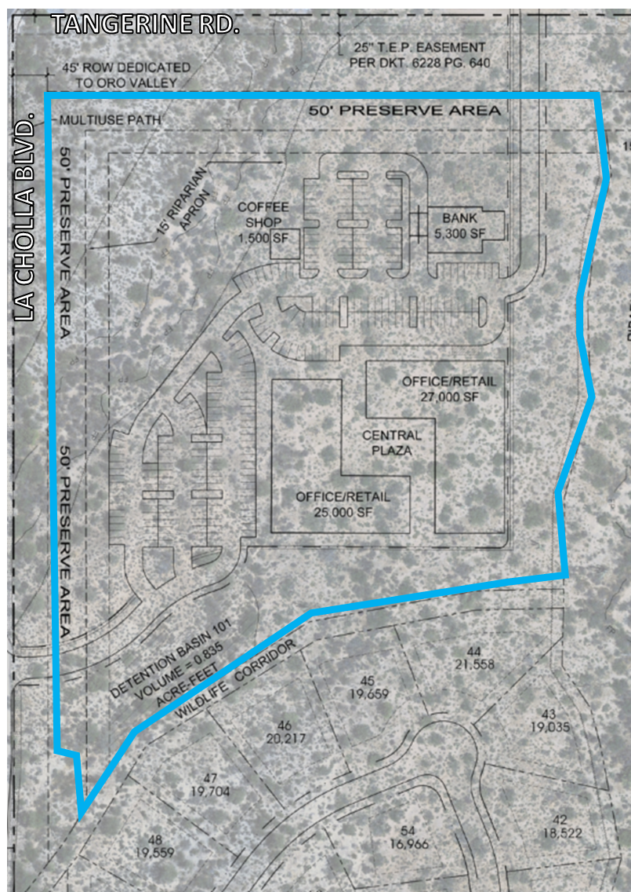
Applicant’s proposal continued
Existing
Proposed
Bank
Wash
Office or Retail
Office or Retail

Slide 7
Your Voice, Our Future General Plan
Long range policy document that drives Town decisions and reflects the Community’s values
Includes the Vision, Guiding Principles, Goals and Policies of the Community, Environment and Development elements
General Plan Land Use Map
Ratified by the voters in 2016
Acknowledges
“…applications are typically made every year…that most often concern changes to the Town’s Land Use Map and generate a significant amount of interest within the community.”
“…residents on the Development Committee, recommended changes to the map be handled through the plan amendment process due to the robust public engagement involved…As such it is anticipated that changes to the map will occur during the lifespan of this plan”
Amendment Criteria
General conformance to the Vision, Guiding Principles, Goals and Policies
Appropriately addresses neighbor concerns
Contributes to the long-term stability of the Town
Notes:
GPA amendments are reviewed for conformance with the criteria onscreen, which I will go thru in coming slides

Slide 8
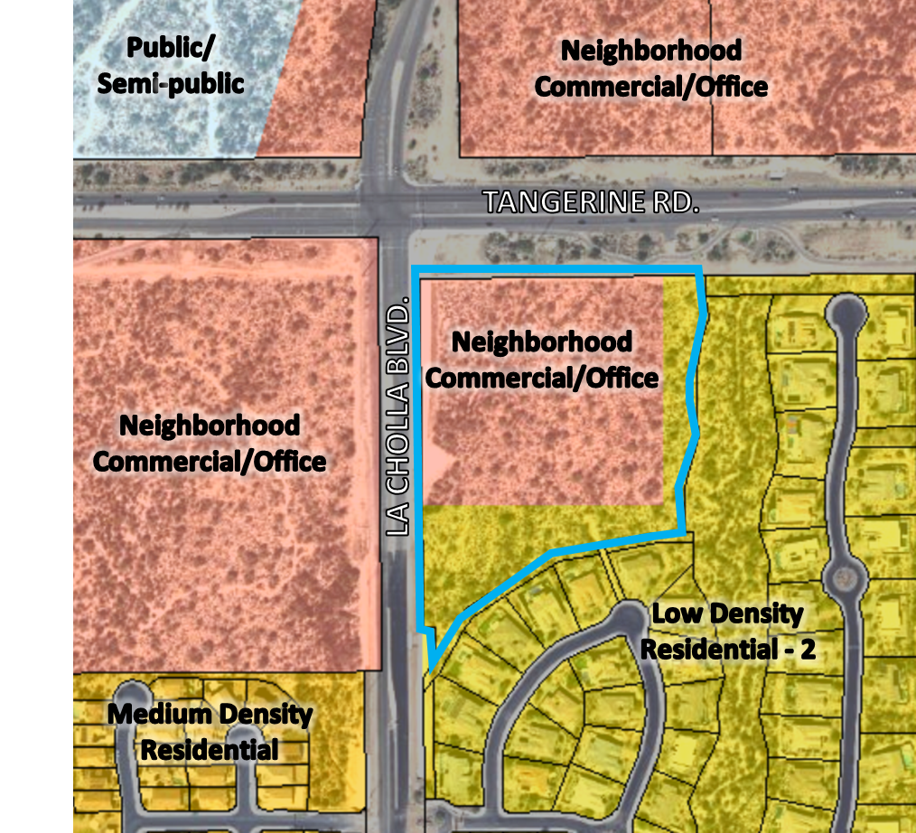
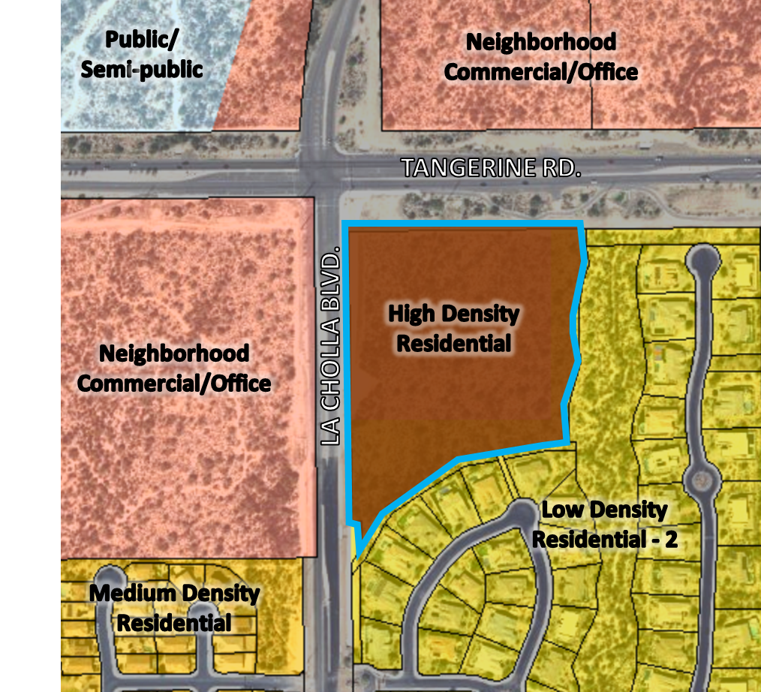
Application 1: Type 1 General Plan Amendment
General Plan Land Use Designations
Existing
Proposed

Slide 9
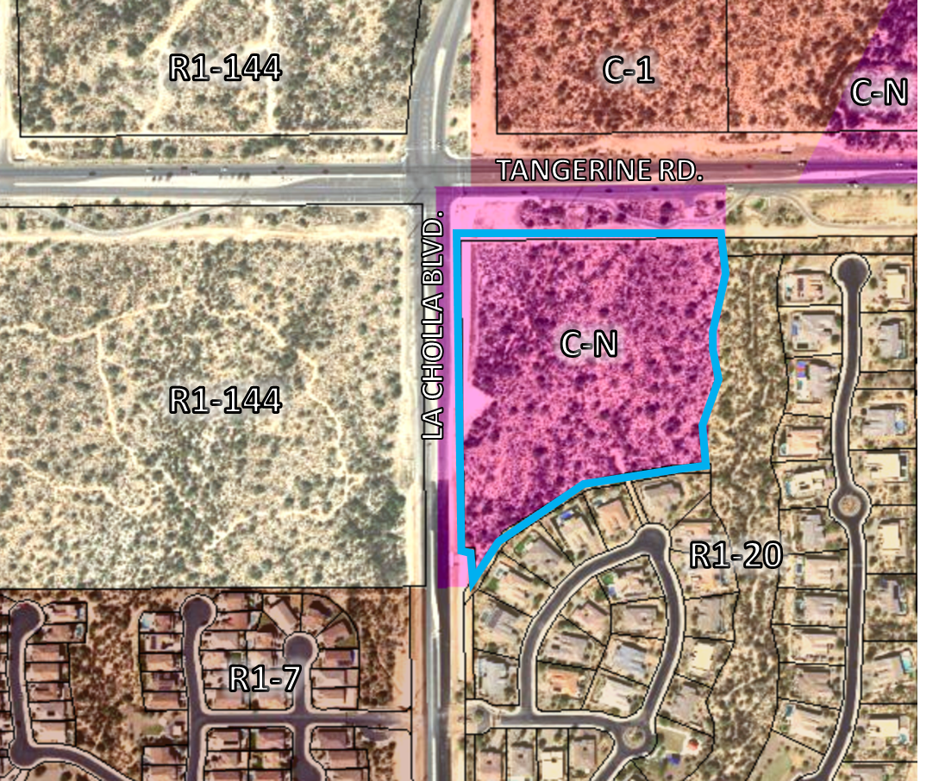
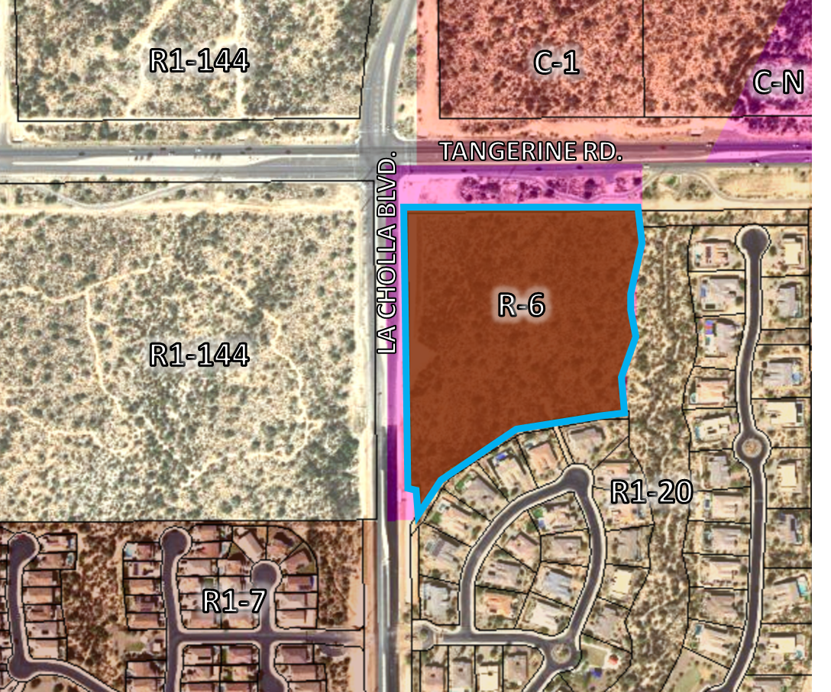
Application 2: Rezoning
Zoning Designations
Existing
Proposed
Max Building Height: 25 feet or 2 stories
Max Building Height: 25 feet or 2 stories
Notes:
1st neighborhood meeting issues:
Density
Specifically Lot size transition to larger lots
Traffic
Water
Bufferyards
Viewsheds

Slide 10
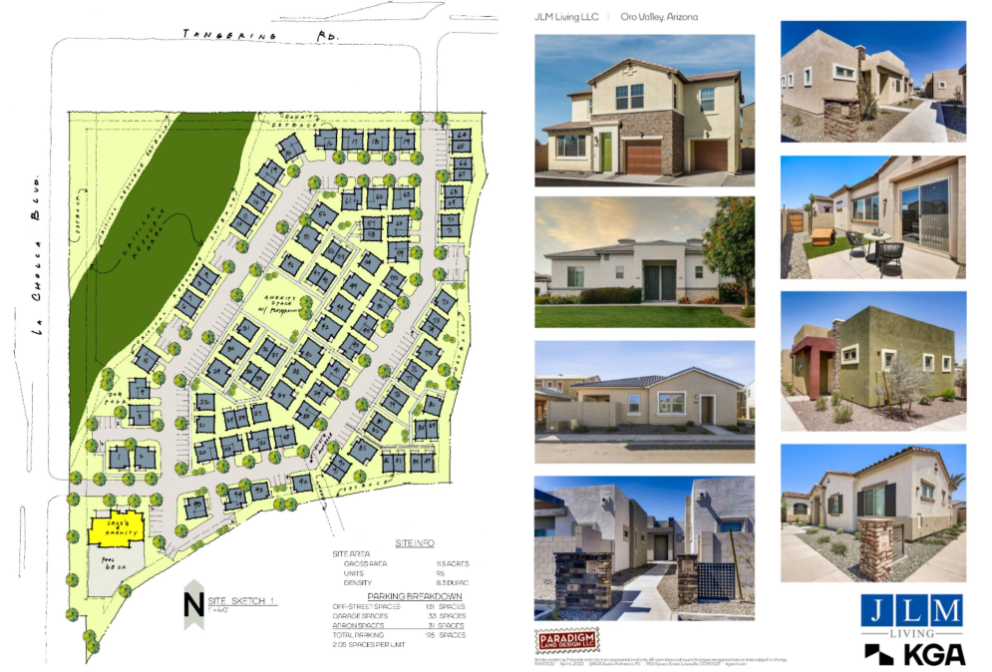
Applicant slides

Slide 11
Informational Video – posted on OVprojects.com April 12, 2022
Formal submittal
2nd Neighborhood Meeting – August (tentatively)
1st Planning and Zoning Commission Hearing – October (tentatively)
Town Council Hearing – December (tentatively)
1st Neighborhood Meeting – April 27, 2022
2nd Planning and Zoning Commission Hearing – November (tentatively)
We are here
Questions: ask@orovalleyaz.gov
Info: www.OVprojects.com

Slide 12
Staff Contact and Project Website
Jessica Hynd
Constituent Services Coordinator
Phone: (520) 229-4711
ask@orovalleyaz.gov
www.OVprojects.com
SEC Tangerine & La Cholla
Type 1 General Plan Amendment and Rezoning

